Slide 1
Two Factor Authentication using Behavioural Analytics
Group- Guided By- Himanshu Yadav (3413) Prof. Sushma Shirke Prem Sakore (3432) Saurav Sen (3445) Sponsored By- Shaurya Khurana (3447) Accops Systems Pvt. Ltd.

Slide 2
Problem Statement
Review I
Two Factor Authentication by implementing Behavioural Analytics of typing patterns on top of the conventional passcode authentication method using machine learning.

Slide 3
Objective
Develop an algorithm to avoid spoofing
Secure access
Access away from home and physical tokens or on a plane with no network coverage for SMS but an internet connection
Low development and maintenance cost
Notes:
Strong against spoofing-
Even with malicious intent, spoofing someone’s behaviour is nearly impossible as it is hard to record and even harder to play back.
Access anytime-
Users can authenticate without searching for their phone or physical token. It is much harder to leave your typing behaviour behind.
Access anywhere-
Access away from home and physical tokens or on a plane with no network coverage for SMS but an internet connection. The only needed parties are the user and a keyboard.
No hardware purchase and maintenance cost-
Typing biometrics requires no complex deployment scheme with hardware purchase, maintenance and replacement and scales immediately
Low development and maintenance cost-
Deployment is quick and easy, requiring much less development than proprietary mobile apps as software tokens.

Slide 4
Literature Survey
Continuous authentication by analysis of keyboard typing characteristics
Learned different keystroke characteristics that can be used in identification criteria
Shepherd, S. J. "Continuous authentication by analysis of keyboard typing characteristics." (1995): 111-114.
A Modified Algorithm for User Identification by His Typing on the Keyboard
In this paper the authors modify their previous kNN algorithm and present a modification to improve the algorithm
Panasiuk, Piotr, and Khalid Saeed. "A modified algorithm for user identification by his typing on the keyboard." Image Processing and Communications Challenges 2. Springer, Berlin, Heidelberg, 2010. 113-120.

Slide 5
Supervised Machine Learning Algorithms: Classification and Comparison
This paper describes various Supervised Machine Learning (ML) classification techniques, compares various supervised learning algorithms as well as determines the most efficient classification algorithm based on the data set, the number of instances and variables (features)
Akinsola, J E T. (2017). Supervised Machine Learning Algorithms: Classification and Comparison. International Journal of Computer Trends and Technology (IJCTT). 48. 128 - 138. 10.14445/22312803/IJCTT-V48P126.
Keyboard Behavior Based Authentication
This paper shows keyboard behavior based on temporary workers employed in a simulated office environment
Juola, Patrick, et al. "Keyboard-behavior-based authentication." IT Professional 15.4 (2013): 8-11.

Slide 6
Biometric Authentication and Identification using Keystroke Dynamics: A Survey
It concludes that the use and acceptance of this biometric could be increased by development of standardized databases, assignment of nomenclature for features, development of common data interchange formats, establishment of protocols for evaluating methods, and resolution of privacy issues.
Banerjee, Salil P., and Damon L. Woodard. "Biometric authentication and identification using keystroke dynamics: A survey." Journal of Pattern Recognition Research 7.1 (2012): 116-139.

Slide 7
Feasibility
Review II
The time taken for the detection of spoofing is very less, so the project becomes feasible for the product.
The code complexity being less makes the project compatible with the final product
The extra memory required by the project is minimal, so it won't impact the CPU .

Slide 8
Scope
Accops System Pvt. Ltd. is going to use this project in their product which is a multi-factor authentication solution.
User will not have to bother passwords and other stuffs .
BUDGET: No cost is involved in the project. All the resources are open source and freely available.
TIME: Approximately in 7 months the project will be completed. Consistent study of 20hrs per week is required.

Slide 9
Milestones
Study about the various machine learning algorithms which can classify the users according to their typing characteristics.
Study about the classification algorithms.
Implement the algorithms in a prototype and check for the results.
Finalize the algorithms based on which has best results and then producing the final product.

Slide 10
Risks
Technical Risks
The accuracy of the model, this may be due to lack of adequate knowledge.
Operational Risks
Convenience of user, this may be due to poor implementation.
Business Risk
Market Acceptance
Incompatible fit for their need

Slide 11
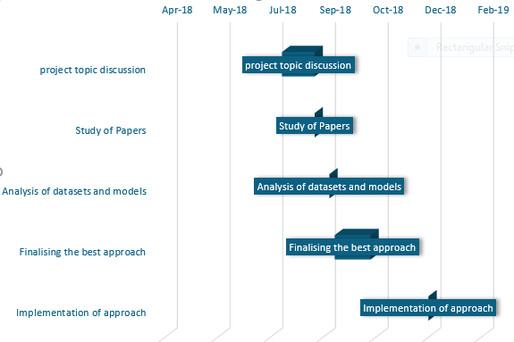
Project Timeline

Slide 12
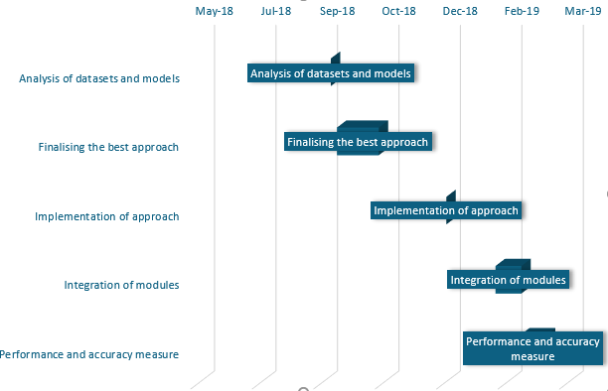

Slide 13
Features
word length,
distribution of characters,
character bigrams,
the percentage of letters/digits/uppercase letters, and numbers (including single, 2-digit, and 3-digit numbers).

Slide 14
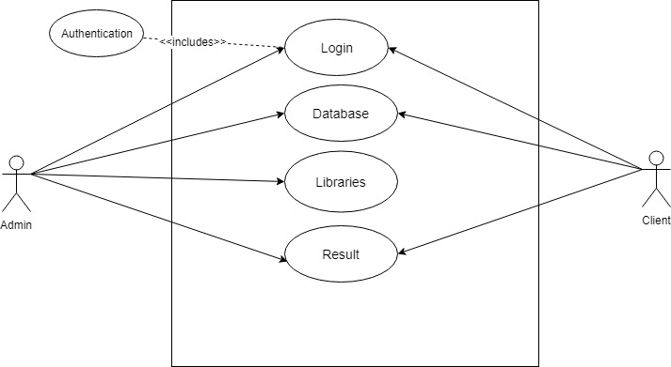
Use Case

Slide 15
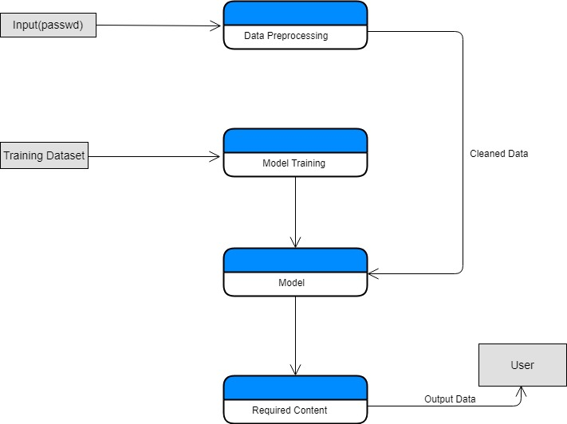
Dataflow

Slide 16
Demand for Product
As all the two-factor authentication solutions in the market use OTP and Biometrics, both of them require a specific hardware to authenticate the user.
This product will only need a person for authentication by using the typing dynamics of the user as their biometrics.

Slide 17
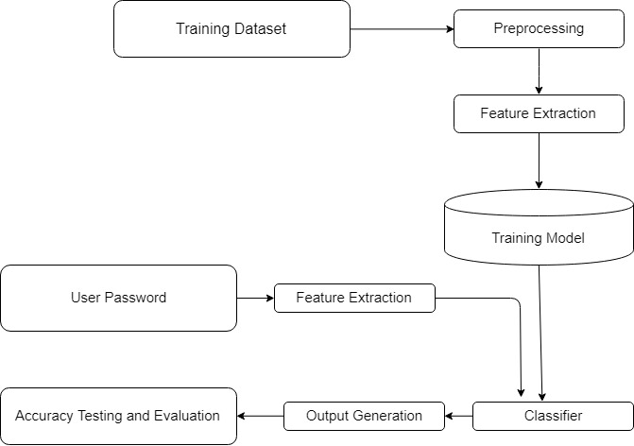
System Architecture
Review IV

Slide 18
Modules
User Interface
Data Training Module
Feature Extraction from Text
Authentication Module

Slide 19
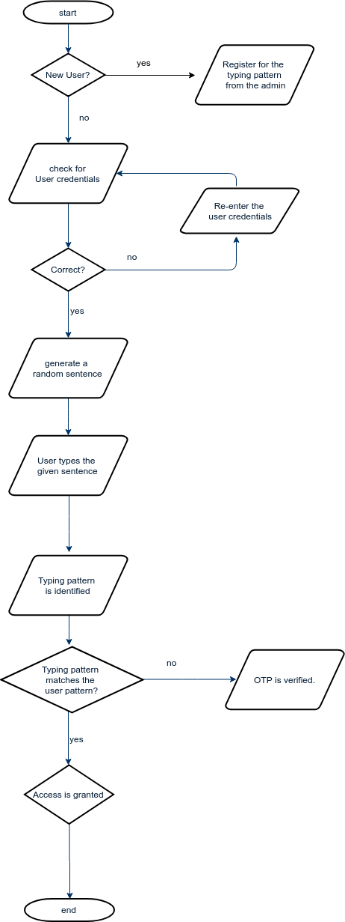
Activity Diagram

Slide 20
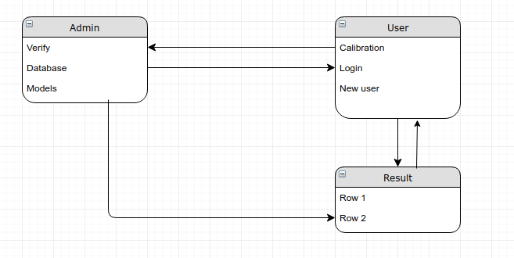
Class Diagram

Slide 21
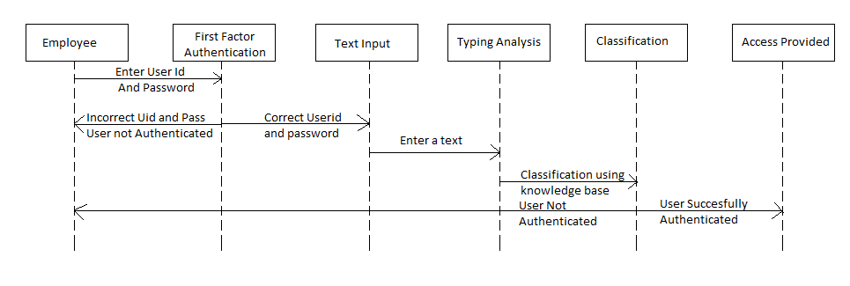
Sequence Diagram

